Slide 1
Family Connects International Roundtables: Maternal and Infant Advocacy and Policies
Presenters: Gretchen Hammer, Public Leadership Group
April 5, 2023

Slide 2
WELCOME AND INTRODUCTIONS
Community Partner Introductions:
Your name
Role in your organization
FC Location
Favorite local restaurant ☺

Slide 3
Zoom Norms
Use the chat to ask questions
Save questions until the allotted time
Allow everyone a chance to share
Please stay muted unless you are speaking

Slide 4
2:00pm-2:05pm: Gather/Introductions in Chat Box
2:05 pm-2:45 pm: Medicaid Presentation w/ Gretchen Hammer from the Public Leadership Group
2:45 pm-3:00 pm: Questions from Community Partners
Schedule

Slide 5
Gretchen Hammer
Founder of the Public Leadership Group,a firm that works with public sector leaders to increase their impact and improve the health and well-being of communities.
She is an expert in leadership development, public administration, stakeholder and community engagement, Medicaid policy and operations and maternal and child health policy.

Slide 6
Basic Program Structure
Medicaid is a joint federal and state program. States and the federal government share in paying for the cost of the program.
Federal law and regulations set basic parameters for the program.
States have a lot of flexibility to build on the basic federal requirements related to eligibility, benefits, financing and innovation.
The State Plan is the document the state files with the federal government that outlines the parameters of their program.

Slide 7
Medicaid Design Elements
Eligibility – Who is eligible to enroll in the program or receive a specific set of services?
Benefits – What benefits and services are available to eligible people?
Provider – Who can provide care and services for which populations?
Delivery system – How is the benefit made available to the enrollee?
Payment – What is the amount paid to the provider? Who pays the provider? Is there any unique aspect of the payment?
Quality – How is quality measured and assured?

Slide 8
Eligibility – Pregnancy/postpartum
By federal law, all states provide Medicaid coverage for pregnancy-related services for pregnant women with incomes up to 133% of the federal poverty level throughout pregnancy an up to 60 days postpartum.
Medicaid covers 4 in 10 births.
New federal law allows states to cover women for an entire 12 months after end of pregnancy.
Notes:
Is there any data that you used to support this?

Slide 9
Eligibility - Newborns
Newborns are generally eligible for Medicaid for the first year of life if their mother is enrolled in Medicaid at the time of birth.
New federal law requires all states to implement 12 months continuous eligibility for children up to age 19 by January 2024.
States report their data for enrolled children and children who receive EPSDT services using form CMS-416.
In 2020, there were 2.1 Million infants under the age of 1 served by Medicaid.
States can find their data in the 2020 416 report

Slide 10
Benefits
Federal rules require states cover certain mandatory services.
States have discretion to cover additional services.
States can also request certain waivers to offer limited benefits, innovative services or services to support individuals with disabilities live in the community.
Notes:
Is there any data that you used to support this?

Slide 11
Family Connects Model
Nurse Home Visiting
Many states have enhanced prenatal and postpartum support services for “high-risk” pregnant people.
Some states have enhanced newborn support services for “high-risk” infants
Some states are using preventive services benefits
Some states have home health services for a post-acute event
Community Alignment
Some states have Targeted Case Management as covered benefit for certain populations
States with Medicaid managed care have care coordination and/or case management requirements for their health plans – some specific to pregnancy and postpartum

Slide 12
Providers and Delivery System
Providers
Most states do not directly enroll Nurses as providers
Many states limit home visiting providers to local health departments
Other providers can provide home visiting services – FQHCs, RHCs, stand alone physical health and behavioral health providers – if allowed in SPA or waiver
Delivery System
Many states provide home visiting services through a network of contracted providers
Local health departments – OR, NC
State defined agencies - FL
Diverse contracted community agencies – ME, CO, MI
Some programs are part of Medicaid managed care others don’t have managed care or are “carved out”

Slide 13
Pre-Submitted Questions

Slide 14
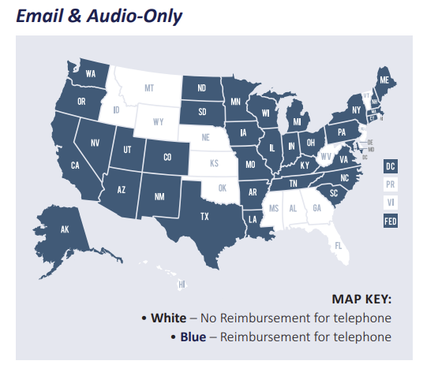
Telehealth
Center for Connected Health Policy - National Telehealth Policy Resource Center
Question – Are phone or telehealth visits an option for Medicaid reimbursement?
Answer – Yes. Most states have codified their telehealth policies since the pandemic.
Illinois and North Carolina – Medicaid pays for live video, remote patient monitoring and audio only.

Slide 15
Private Insurance
Some states have required some state regulated private health insurance carriers to cover Family Connects – OR and NJ.
To bill private health insurance Family Connects providers would need to ensure:
The family is enrolled in coverage.
The benefit is offered.
The provider is a credentialed and contracted provider.
Question – Can we bill private health insurance for providing Family Connects services.
Answer – Unlikely. Most private health insurance plans do not cover postpartum or newborn nurse home visiting nor care coordination/case management.

Slide 16
Payment
Medicaid payment requires a state budget appropriation.
Each state sets a fee schedule for services covered by the program.
Some states use CPT Code 99502 to cover home visit for newborn.
North Carolina LHD – 99502 $60.00
Colorado Preventive Counseling – 99401-99404 - $34.29 – $105.09
Most states use T1017 for targeted case management
North Carolina LHD - $23.61 per 15 min unit
Colorado - $16.99 per 15 min unit
Question – What proportion of the Family Connects program costs will Medicaid cover?
Answer – It depends, but most research on home visiting models have shown that Medicaid can not be the sole source of financing for models.

Slide 17
FCI Community Partner Webinar Series
July 2023: Policy
September 2023: Clinical
November 2023: Implementation and Systems Alignment
January 2024: Community Impact
March 2024: Best Practice, topic TBD
May 2024: Best Practice, topic TBD

Slide 18
Questions

